Slide 1

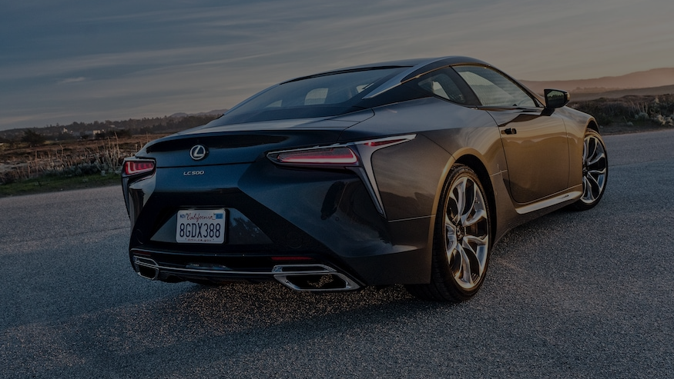
Car Recommender
Omar Qusous
https://github.com/oqusous/car_recommendation_

Slide 2
Content based Recommender for cars
Notes:
Maybe not a car person, lived in a city like NY and never used one?
- like once car that you saw somewhere or a friend owned, want it or something similar--- explore your options!!!
“Buyer’s remorse, especially for high-ticket items, happens all the time. And it makes everyone involved unhappy,” wrote Kimberly Palmer in an article in U.S. News Money.
Besides taking your time and doing your research beforehand, AutoTrader suggests that shoppers:
Decide on a price limit before heading out to the dealership. The price limit should be part of a budget that ensures a car purchase doesn’t jeopardize your overall financial well-being.
Set realistic expectations on whether to shop for a new or used car – are you sure you can afford that new model or is a used vehicle a more sensible purchase?
Take family members or a friend to the dealership to shop with you to act as a voice of reason, and make sure you don’t do something you’re liable to regret a few days later.
Take a long (or extended) test drive on familiar roads – the type you’ll drive if you buy the car. Only then will you know whether you’re comfortable that it will meet your everyday needs.
Allow enough time to think about your vehicle-purchase decision before signing any papers. Decisions made in haste are more likely to result in buyer’s remorse.
Ask the dealership about any return policy before you buy the vehicle just in case you decide that you’ve made a mistake, “since some dealers do offer a 24-hour return policy.”

Slide 3
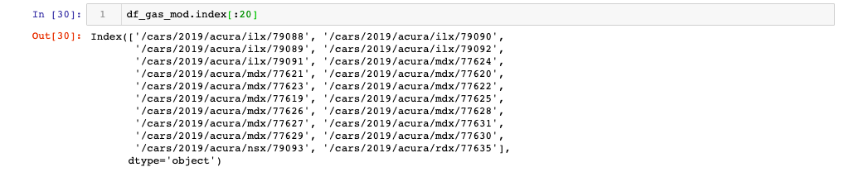
Data Sources
https://www.carspecs.us -BS4
https://www.kbb.com/ - Selenium
All models and trims of 43 Car brands - 2234 in total
5 trims of Acura ILX model
12 trims of Acura MDX model

Slide 4
Features
Physical: external and internal dimensions and weight of the car
Performance: Horsepower, Cylinders, Torque and Gear Ratios
Value: Price
Engine type: Fuel Capacity, Hybrid or Gas and miles/gallon
Total- 35 features

Slide 5
Feature Engineering
Domain knowledge selection
Continuous Features:
MinMaxScaler
Feature interaction: interior space and gear ratios
Categorical
Dummies for passenger capacity, engine type, number of cylinders, etc..
Missing data mainly handled using KNN Classifier and Regressor

Slide 6
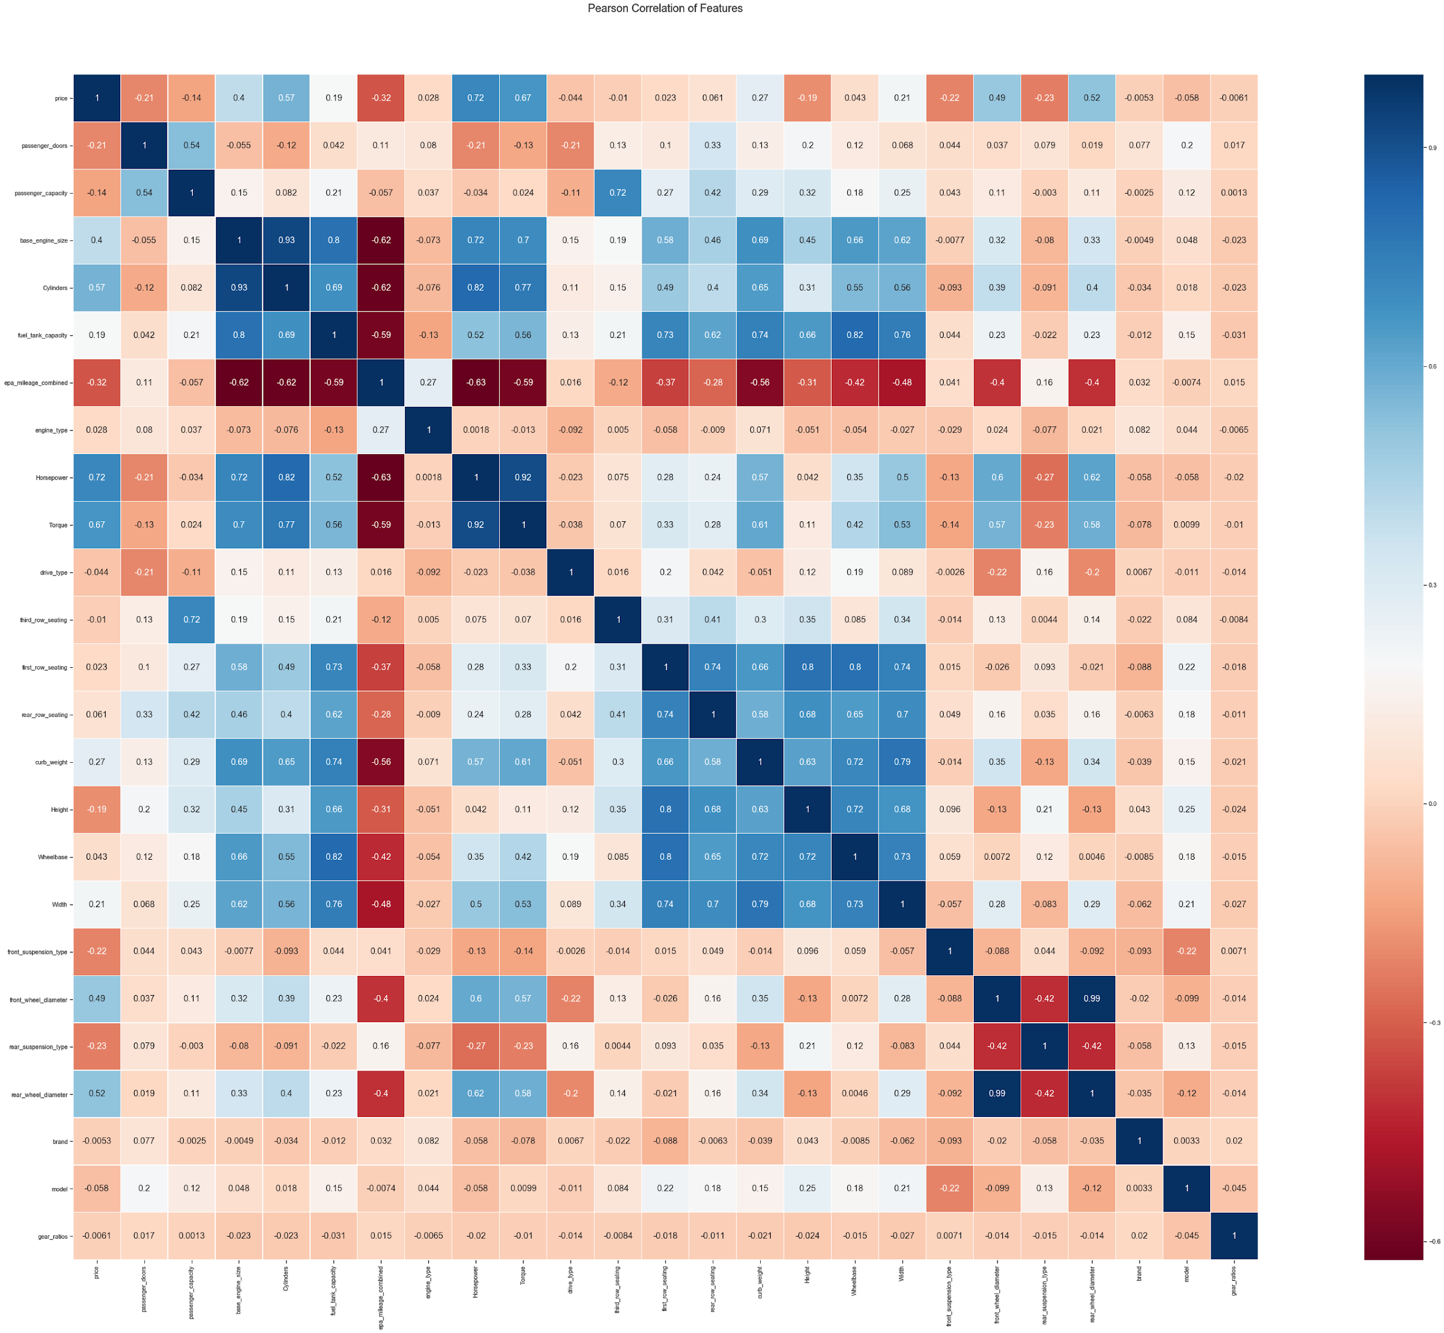
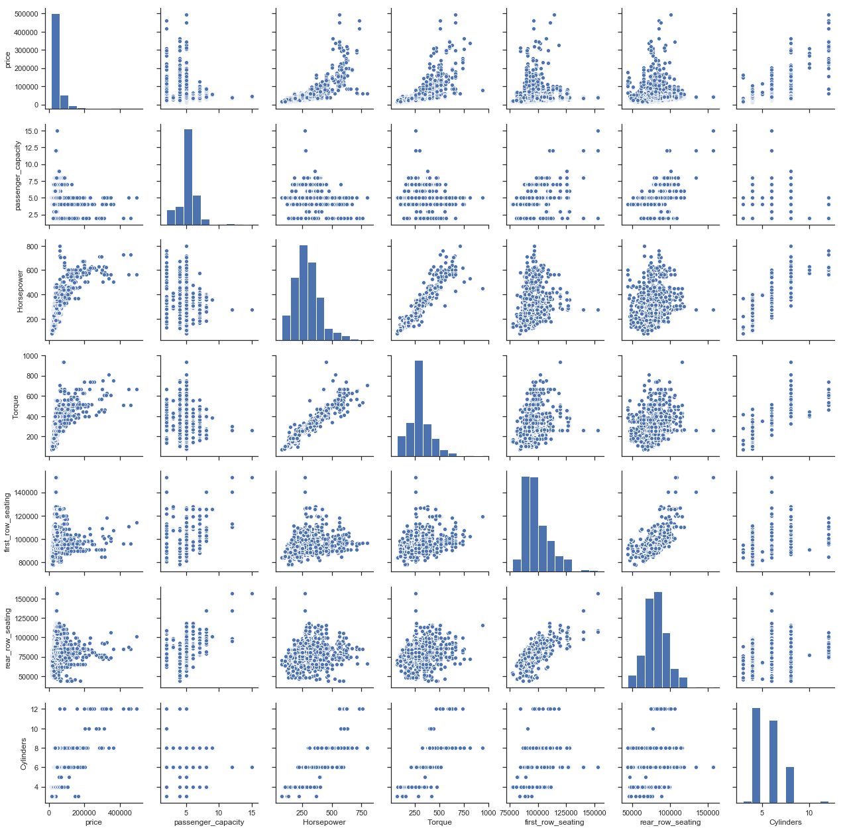
EDA 1 - Corr Heatmap and Feat. Pair Plots

Slide 7
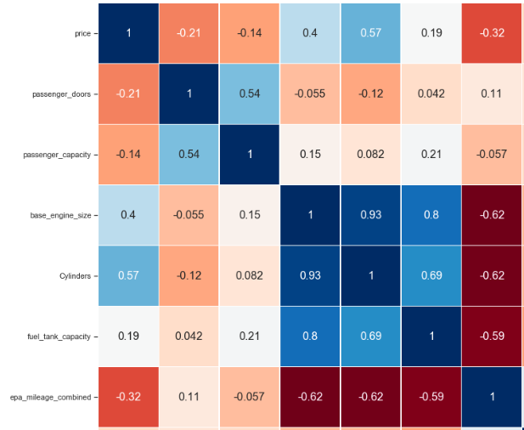
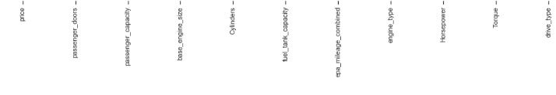
EDA 2
Price
No. Doors
Pass Cap.
Engine size
Cylinders
Fuel tank
mile/gallon

Slide 8
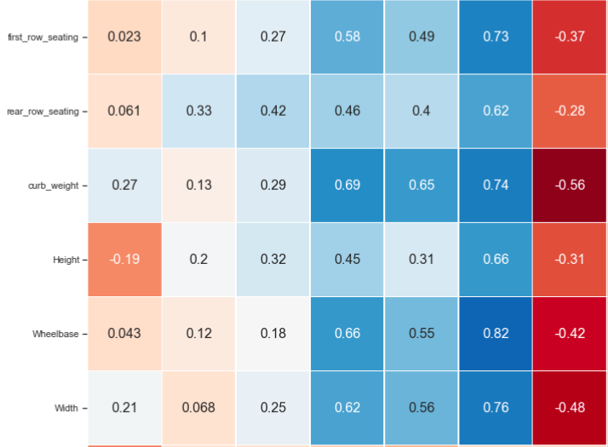
EDA 3
Front seats
Second seats
Weight
Height
Length
Width
Price
No. Doors
Pass Cap.
Engine size
Cylinders
Fuel tank
mile/gallon

Slide 9
Modelling
Clustering:
KMeans
KAgglomerativeClustering
Annoy - Spotify made

Slide 10
KAgglomerativeClustering v Kmeans
Clusters, k, varied between 20-250; k=110 gave best results.
Ward linkage in KAgglomerativeClustering parameter outperformed the rest of the available methods.
Both were run with and without PCA.

Slide 11
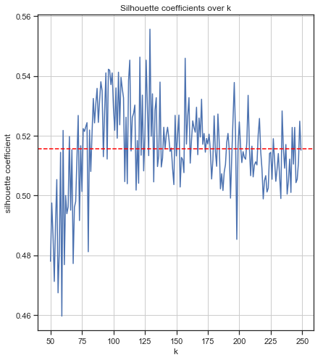
KMeans
Silhouette
Plot

Slide 12
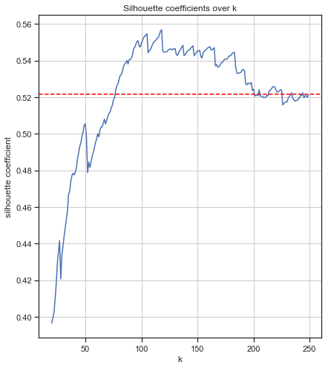
KAgglomerativeClustering
Silhouette
Plot

Slide 13
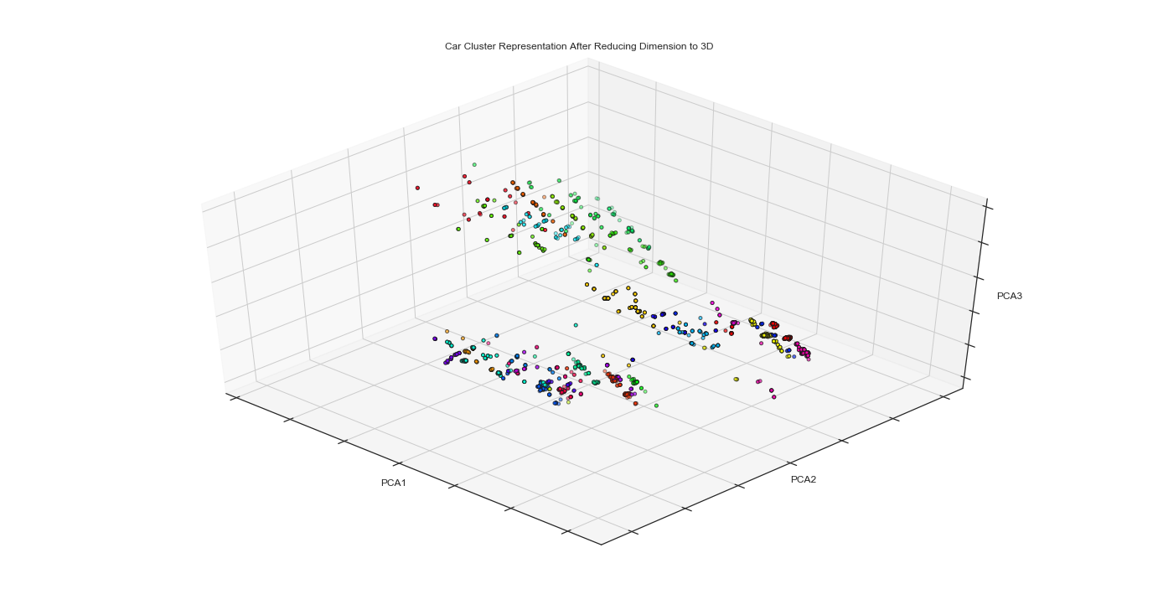
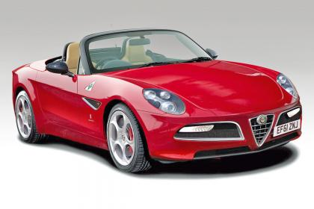
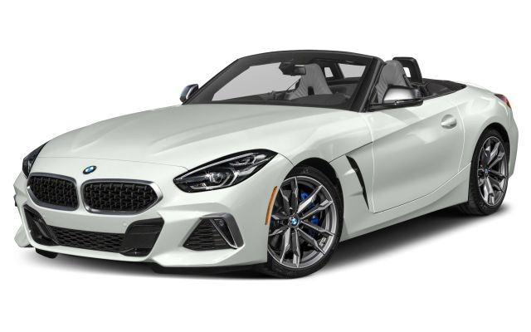
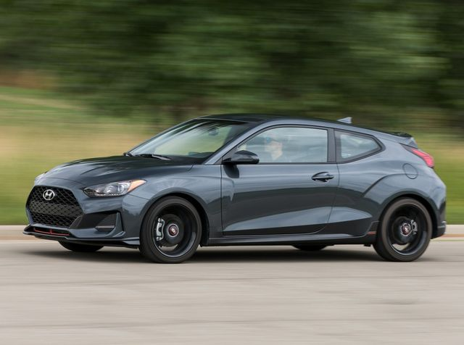
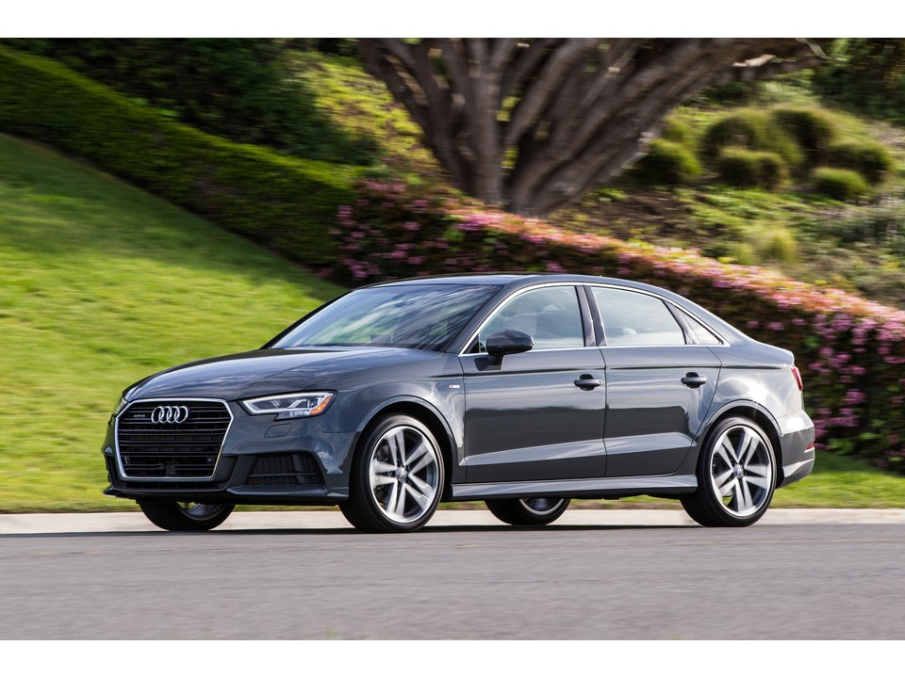
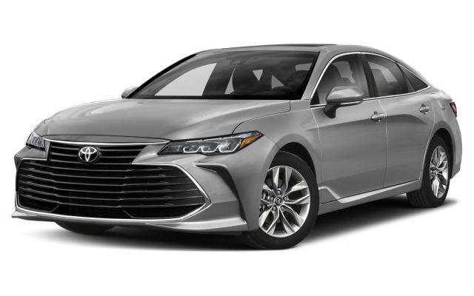
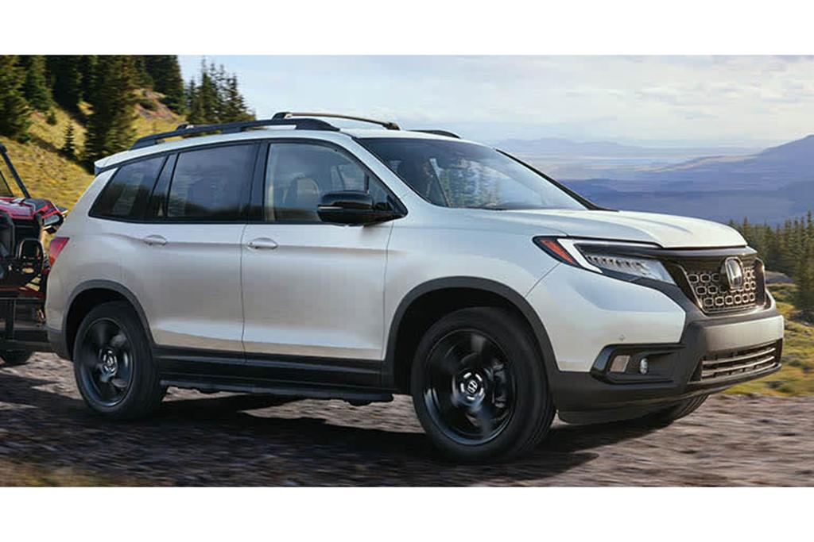
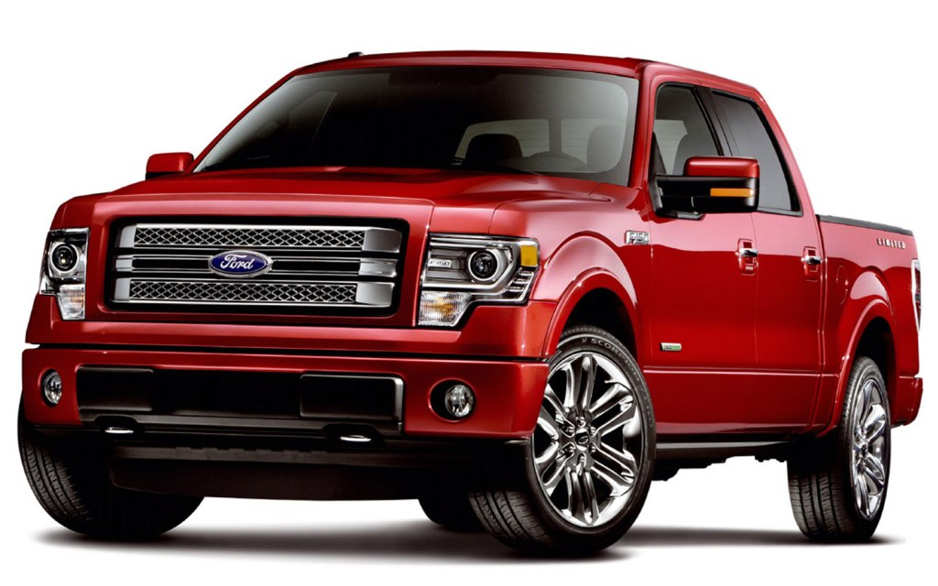
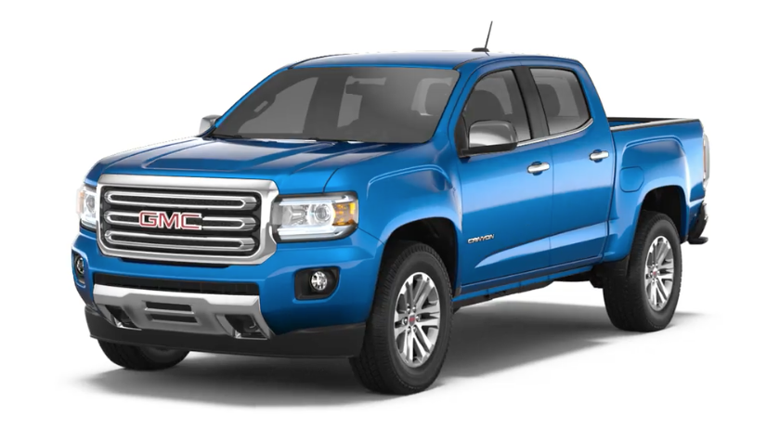
Three component PCA KMeans plot
Labels 3
/cars/2018/alfa-romeo/4c-spider/69017, /cars/2019/bmw/z4/79154
and 22
/cars/2019/hyundai/veloster/78496, /cars/2019/audi/a3-cabriolet/77681
Labels 21
/cars/2019/honda/passport/79308,, /cars/2019/toyota/avalon/78960
and 17
/cars/2019/gmc/canyon/78326, /cars/2019/ford/f-150/79212
* For illustrative purpose only

Slide 14
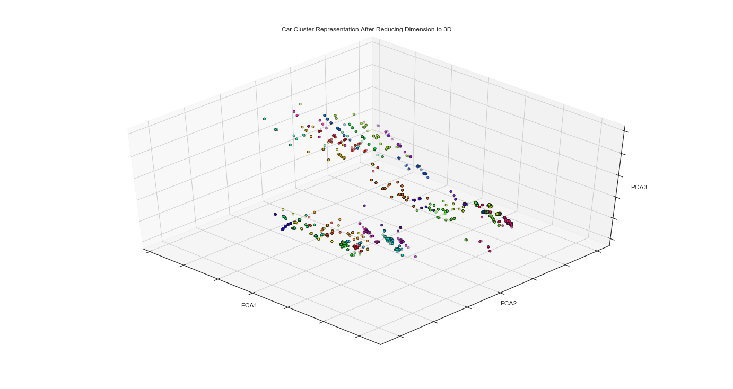
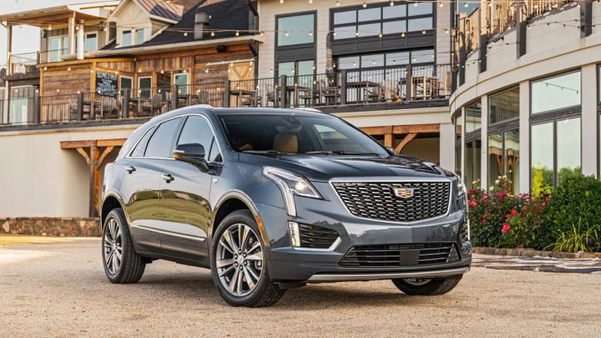
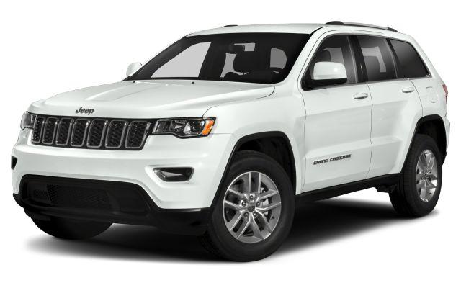
Three component PCA KAgglomerativeClustering plot
Label 18
/cars/2018/alfa-romeo/4c-spider/69017, /cars/2019/audi/a5/77701
Label 77
/cars/2019/hyundai/veloster/78496
Label 4
cars/2019/ford/f-150/79212, /cars/2019/gmc/canyon/78326
Label 24
/cars/2019/cadillac/xt5/77895, /cars/2019/jeep/grand-cherokee/78590
* For illustrative purpose only

Slide 15
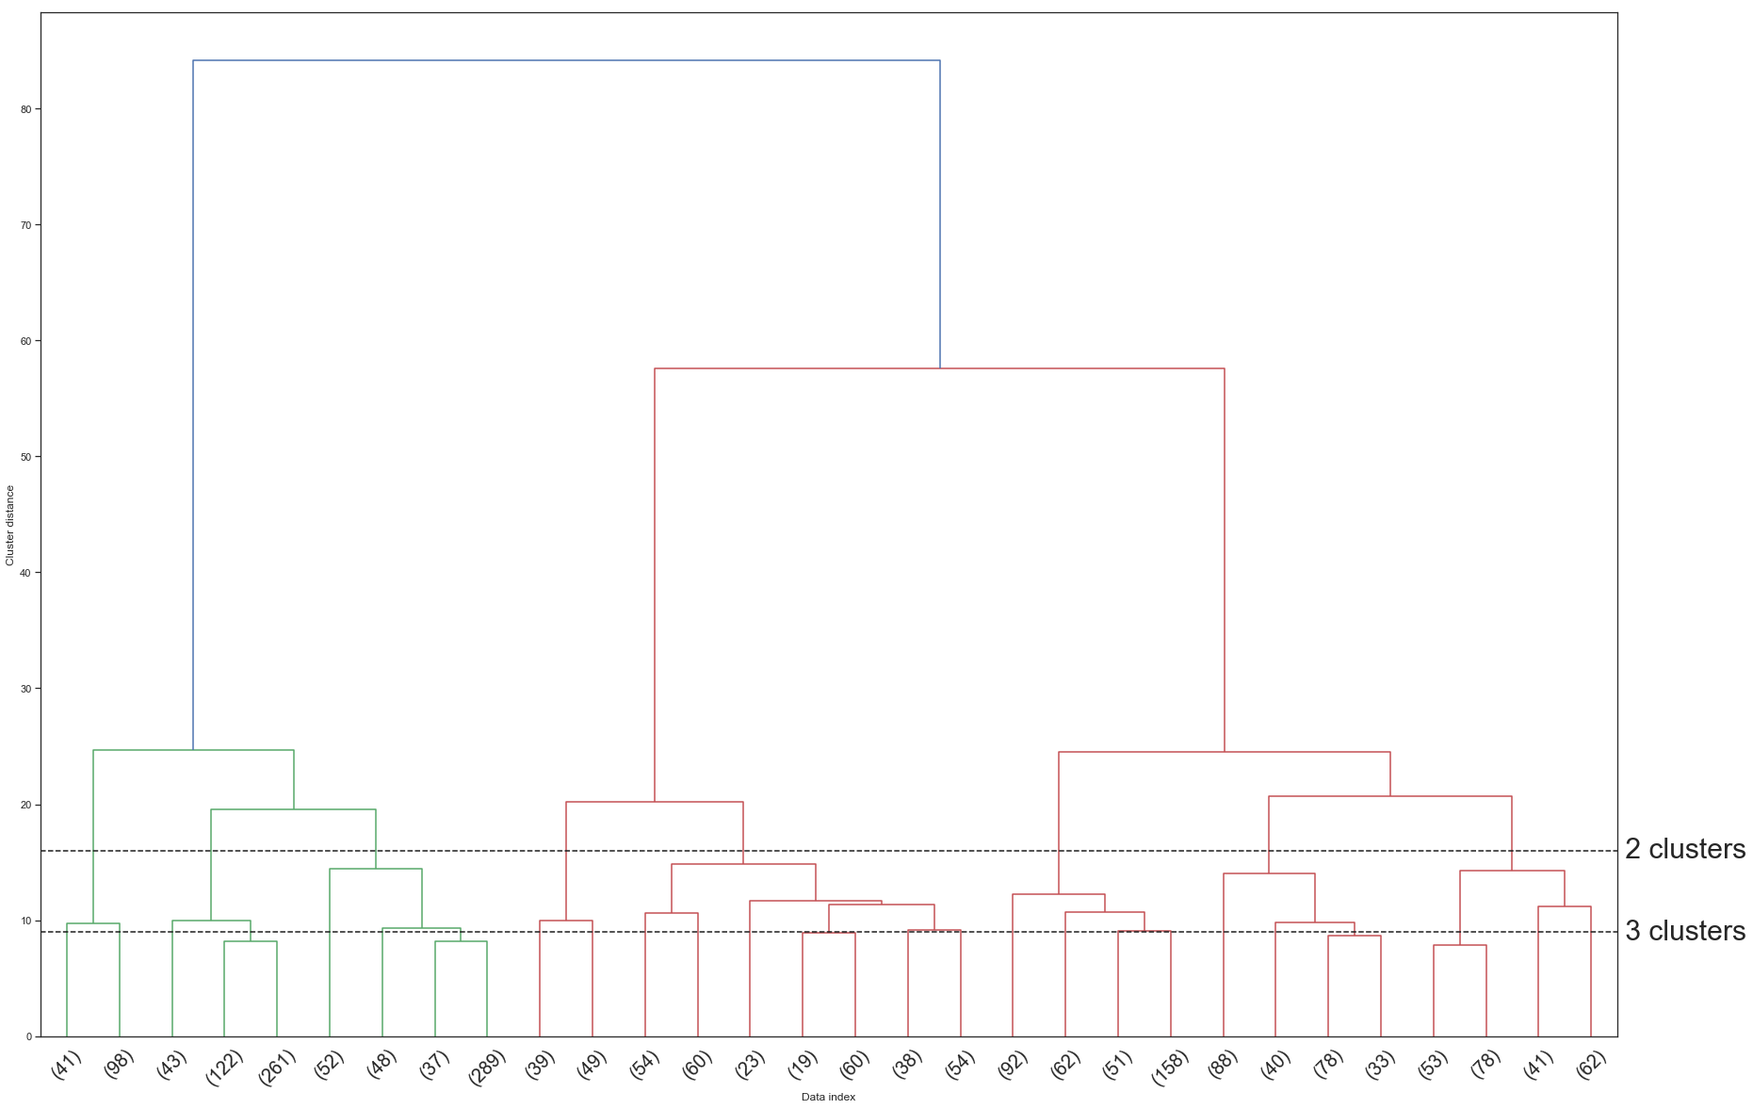
KAgglomerativeClustering Ward Dendogram
411 and 19

Slide 16
K Means v KAgglomerativeClustering
Model | calinski_harabasz_score | silhouette_score
KMeans (k=30,) | 642 | 0.43
KAgglomerativeClustering (k=110, linkage = single) | 289 | 0.54
KAgglomerativeClustering (k=110,linkage = ward) | 811 | 0.55
KAgglomerativeClustering (k=110,linkage = average) | 428 | 0.58
KAgglomerativeClustering (k=110,linkage = complete) | 475 | 0.53
PCA 15 Components with KAgglomerativeClustering | 730 | 0.48

Slide 17
Annoy (Approximate Nearest Neighbors Oh Yeah)
https://github.com/spotify/annoy
Annoy is a C++ library with Python bindings to search for points in space that are close to a given query point. It also creates large read-only file-based data structures that are mmapped into memory so that many processes may share the same data.
It achieved the best results

Slide 18
Annoy + Streamlit Script
from sklearn.decomposition import TruncatedSVD svd = TruncatedSVD(n_components=11) df_Annoy_svd = svd.fit_transform(df_gas_mod) print(np.cumsum(svd.explained_variance_ratio_)) [0.40968461 0.61621028 0.69876376 0.75899439 0.81644876 0.85216069 0.88574629 0.91152626 0.92917066 0.94224498 0.95301177]
Vectorize features
from annoy import AnnoyIndex f = df_Annoy_svd.shape[1] # Length of item vector that will be indexed t = AnnoyIndex(f) for i in range(df_Annoy_svd.shape[0]): v = df_Annoy_svd[i] t.add_item(i, v) t.build(15) t.save('annoy_svd.ann')
builds a forest of n_trees trees. More trees gives higher precision. AnnoyIndex(f, metric) returns a new index that's read-write and stores vector of f dimension
def nearest_car_Annoy(df, car_idx, index, n): nn = index.get_nns_by_item(car_idx, n) print('Closest to %s : \n' % df.index[car_idx]) cars = [df.index[i] for i in nn] return df_for_brands_gas.loc[cars, ['brand','model','Torque','senger Capacity', 'price', 'trim']]
Function to find nn by index

Slide 19
What is next?
Integrate electric cars
2020 models
Find other data sources to scrape for cars that required more KNN predictions
Hybrid recommender with user and expert ratings
Formulate value for options like infotainment system and interior material quality.

